Slide 1
Would you like to earn from digital marketing?

Slide 2

Affiliate Marketing
Anshu Sharma

Slide 3
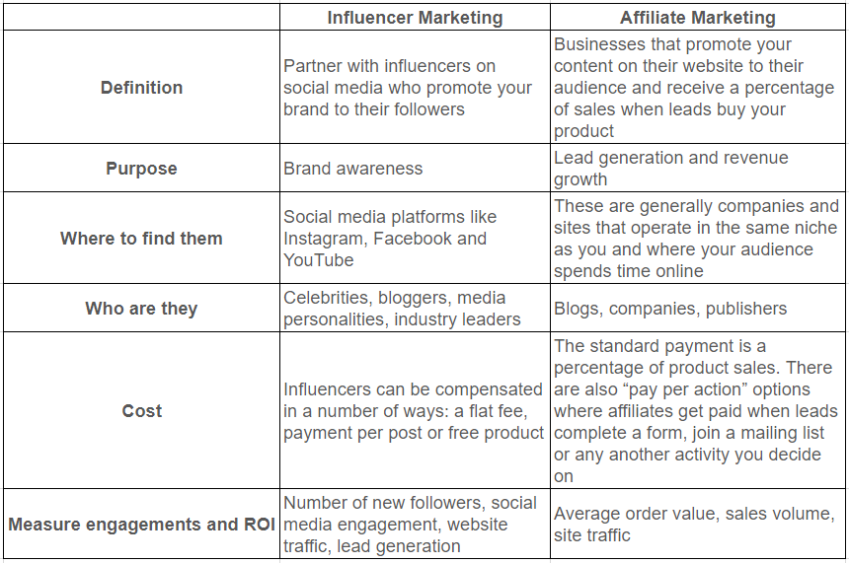

Slide 4
Process
Selecting a Niche
Domain selection
WordPress/Wix
ChatGPT for SILO structure
Website Theme and Customization
Plugins (Page Generator, etc.)
Keyword Research using SEMRUSH
Content Outline Using ChatGPT
Create Vast & Unbiased content
SEO, GSC, Sitemap

Slide 5
Silo structure
Give me a SILO structure for my new website for a new MBA school

Slide 6
Keyword research using semrush
smartwatch: Keyword Magic Tool (semrush.com)

Slide 7
Blog Outline
AIPRM for ChatGPT - Microsoft Edge Addons
"Best smartwatch under "X" rupees"

Slide 8
Content creation using chatgpt
This is the outline for my new blog Choosing Excellence: The Definitive Guide to Finding the Best Business School in "X". Write a section about What Makes a Business School the "Best"?

Slide 9
Selecting products to market

Slide 10
Signing into the amazon affiliate program
Amazon.in Associates Central

